Slide 1
Full Stack
Oscar Chavarria C.

Slide 2
Full Stack Developer
What is a Full Stack Developer?
Most common skill sets:
Front-end / Back-end development.
Databases knowledge. ( SQL & NoSQL )
Knowledge of security concerns and best practices.
Control version.
Agile methodology knowledge
Notes:
A full stack developer is a web developer or engineer who works with both the front and back ends of a website or application—meaning they can tackle projects that involve databases, building user-facing websites, or even work with clients during the planning phase of projects.
A person who knows how to handle every aspect of a web site.
Now, contrary to what a lot of people think, “full stack” doesn’t necessarily mean a developer is writing all of a site’s code themselves. Many full stack web developers spend the majority of their time in either the front or back end code of a site.
A full stack engineer is a senior level role for someone with the skills of a full stack developer (as described above), but with project management experience in things like systems administration (configuring, managing, and maintaining computer networks and systems).
The skill set is not written in stone, it may depend on the perception and in the company requierement.

Slide 3
Full Stack Developer
Advantages:
Broader angle of views and a more active mindset.
Can always have his/her opinions towards the product or design.
Can provide help to everyone in the team.
Greatly reduce the time and technical costs of team communication, technology docking.
Disadvantages
Know a little about the multiple skills.
Notes:
ADV:
Broader angle of views and a more active mindset.
Full stack developer can see problems from different point of view, he/she predict possible issues in other modules and solve them faster.
Can always have his/her opinions towards the product or design.
Because a ST dev knows a lot of technologies he/she gets a more accurate opinion at the time of giving it.
Can provide help to everyone in the team.
A ST dev can be involve in any part of the project a provide help when needed.
Greatly reduce the time and technical costs of team communication, technology docking.
A ST can act as a referee of the team at the time of deciding, because of his knowledge in all the areas.

Slide 4

Modularity
Refers to the extent to which a software/Web application may be
divided into smaller modules and each module serves a specific
purpose.
Unity.
What’s the benefit of modularity ?
Notes:
modularity is the degree to which a system's components may be separated and recombined, often with the benefit of flexibility and variety in use. The concept of modularity is used primarily to reduce complexity by breaking a system into varying degrees of interdependence and independence across and "hide the complexity of each part behind an abstraction and interface." However, the concept of modularity can be extended to multiple disciplines, each with their own nuances. Despite these nuances, consistent themes concerning modular systems arise.
Unity – A component itself is not that effective but when it gets combine is when the magic gets done.
Benefit:
Increases scalability. New functionalities may be easily programmed in separate modules.
When a software needs to be testable, having it modular makes the test more accurate, faster and easier to find and fix the bug.
If a module fails, only that module will be down and not the whole app. The downtime is decease.
Reusability. Modules can be reuse in other projects. Ex: The same email or auth module can be use in multiple projects.

Slide 5
Full Stack Dev
Front- end
Back-end
Database
DevOps
Containerize
Single Page Applications
- Angular
- React
API’s
- .net
- Nodejs frameworks
NoSQL
MongoDB
CMDB
CI/CD
Control -Version
Docker
Kubernetes

Slide 6
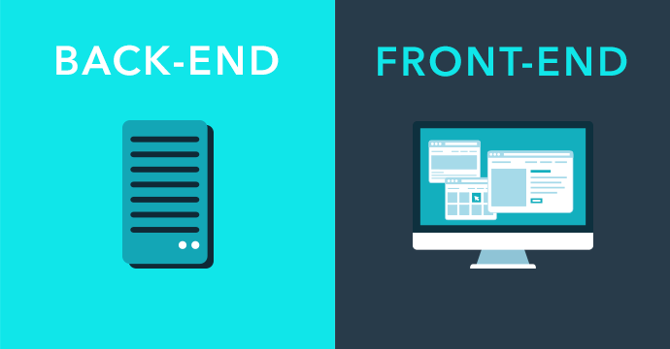

Slide 7
Front End
The front end of a website (or web or mobile application) is the part
a user sees and directly interacts with. The front end is built with
languages like:
HTML ( HTML 5 )
CSS ( CSS 3 )
JavaScript ( ECMA ^6 )
Notes:
HTML (HyperText Markup Language) is the backbone of the Web. Every website you visit is built with HTML. It takes care of all the structure and content. HTML5 is the current iteration of HTML on the Web, although sites built with older versions still run fine in your browser.
CSS (Cascading Style Sheets) is what controls the way the HTML looks on the page. CSS sets the colors, fonts, background images, and even the way the page is laid out (you can use CSS to arrange the HTML elements on a page however you want, even if it’s different than the order they’re arranged in the HTML file). CSS3 is the current iteration of CSS on the Web, and it adds a ton of features for things like basic interactivity and animations.
JavaScript: often abbreviated as JS, is a high-level, interpreted scripting language that conforms to the ECMAScript specification. JavaScript has curly-bracket syntax, dynamic typing, prototype-based object-orientation, and first-class functions.

Slide 8
Single Page Applications
What is a Single Page Application ?
JavaScript frameworks that works like SPA:
Angular
React
The most important feature of these application is the use of components.
Notes:
- Present a demo of angular and react.

Slide 9
Back End
The “under the hood” parts of websites that users don’t interact with directly.
Back-End role:
Ensure that the data or services requested by the front-end system or software are delivered through programmatic means.
Consists of the core application logic, databases, data and application integration, API and other back-end processes.
Ensures atomicity by testing ( usually automatic tests ) of all the modules.
Notes:
The key job role of a back-end developer is to ensure that the data or services requested by the front-end system or software are delivered through programmatic means.
Back-end developers also create and maintain the entire back-end of a system, which consists of the core application logic, databases, data and application integration, API and other back-end processes.
Ensures consistency by testing ( usually automatic tests ) of all the modules.

Slide 10

API’s (Application programming interface )
What is an API ?
Common uses for API’s:
Authentication/Authorization.
Exposing a useful data that can be consume by all clients.
Monitoring
Providing Services (CRUD on objects)
One of the popular languages to write API’s is Nodejs, and since is so you can find many frameworks that uses NodeJS for example SailsJS.
Notes:
An application program interface (API) is a set of routines, protocols, and tools for building software applications. Basically, an API specifies how software components should interact. Additionally, APIs are used when programming graphical user interface (GUI) components. A good API makes it easier to develop a program by providing all the building blocks. A programmer then puts the blocks together.

Slide 11

Databases
A structured set of data held in a computer, especially one that is accessible in various ways. In a program the database is where we are going to store all of our important/sensible data. That’s why is very important we keep this data secure. But now a days is also very important to always have this data available and that’s what we called a high availably database.
Two popular type of languages to interact with database are SQL and NoSQL.
Notes:
Ask ? Important sensible data:
credentials,
banking information,
personal information.
Who can we keep our data secure ?
Backups.
Encryption.
Keep up with the updates.
Who can we achieve a High Availability ?
Implement multiple application servers ( modularity),
Redundancy? Raids, availability groups.
use of a virtualized server for zero-downtime recovery,

Slide 12
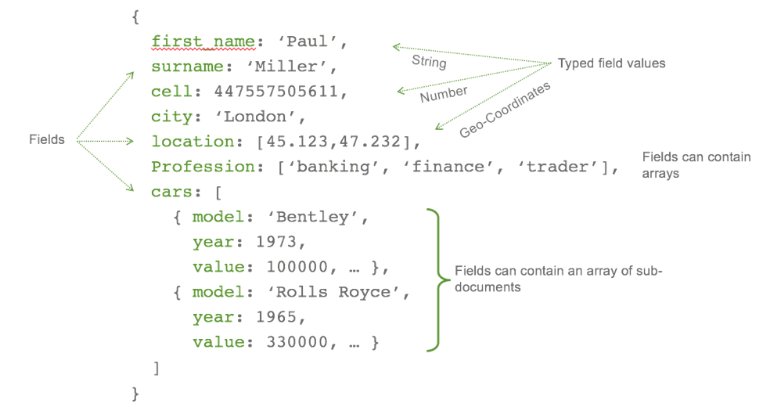

Mongo DB (NoSQL)
MongoDB is a cross-platform document-oriented database program. Classified as a NoSQL database program, MongoDB uses JSON-like documents with schema.
Notes:
MongoDB is a cross-platform document-oriented database program. Classified as a NoSQL database program, MongoDB uses JSON-like documents with schema.
JSON vs Diccionaries vs Hash Table.

Slide 13
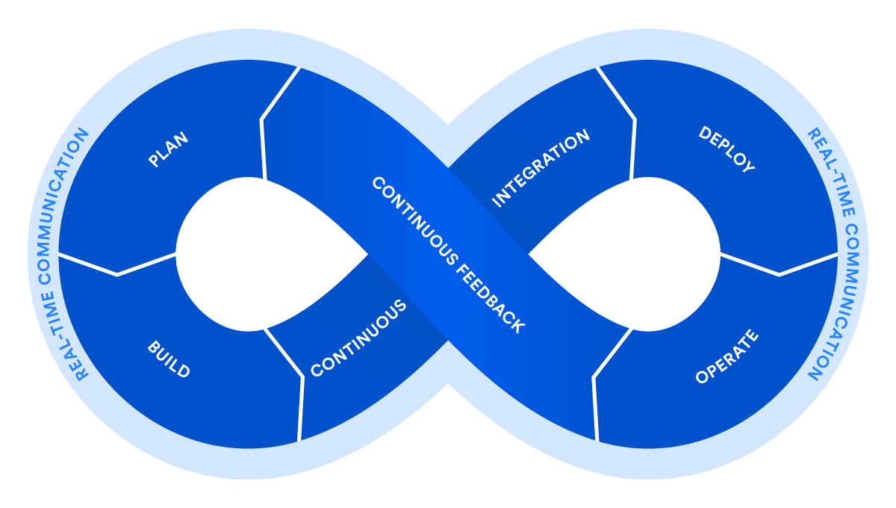
DevOps
DevOps is a set of practices that automates the processes between software development and IT teams, in order that they can build, test, and release software faster and more reliably.
Benefits:
Collaboration
Fast response
Adapts to the change
Notes:
DevOps is a set of practices that automates the processes between software development and IT teams, in order that they can build, test, and release software faster and more reliably.
Collaboration: Adopting a DevOps model creates alignment between development and operations teams; handoff friction is reduced and, everyone is all in on the same goals and objectives.
Shorter cycle time: A devops teams works in shorter cycle times an is constantly releasing new but small features.
Adapts to the change: because the ops is constantly needing changes and adjusting to the business needs, a dev ops teams need to be prepare to tackle the needs and adopt it.

Slide 14
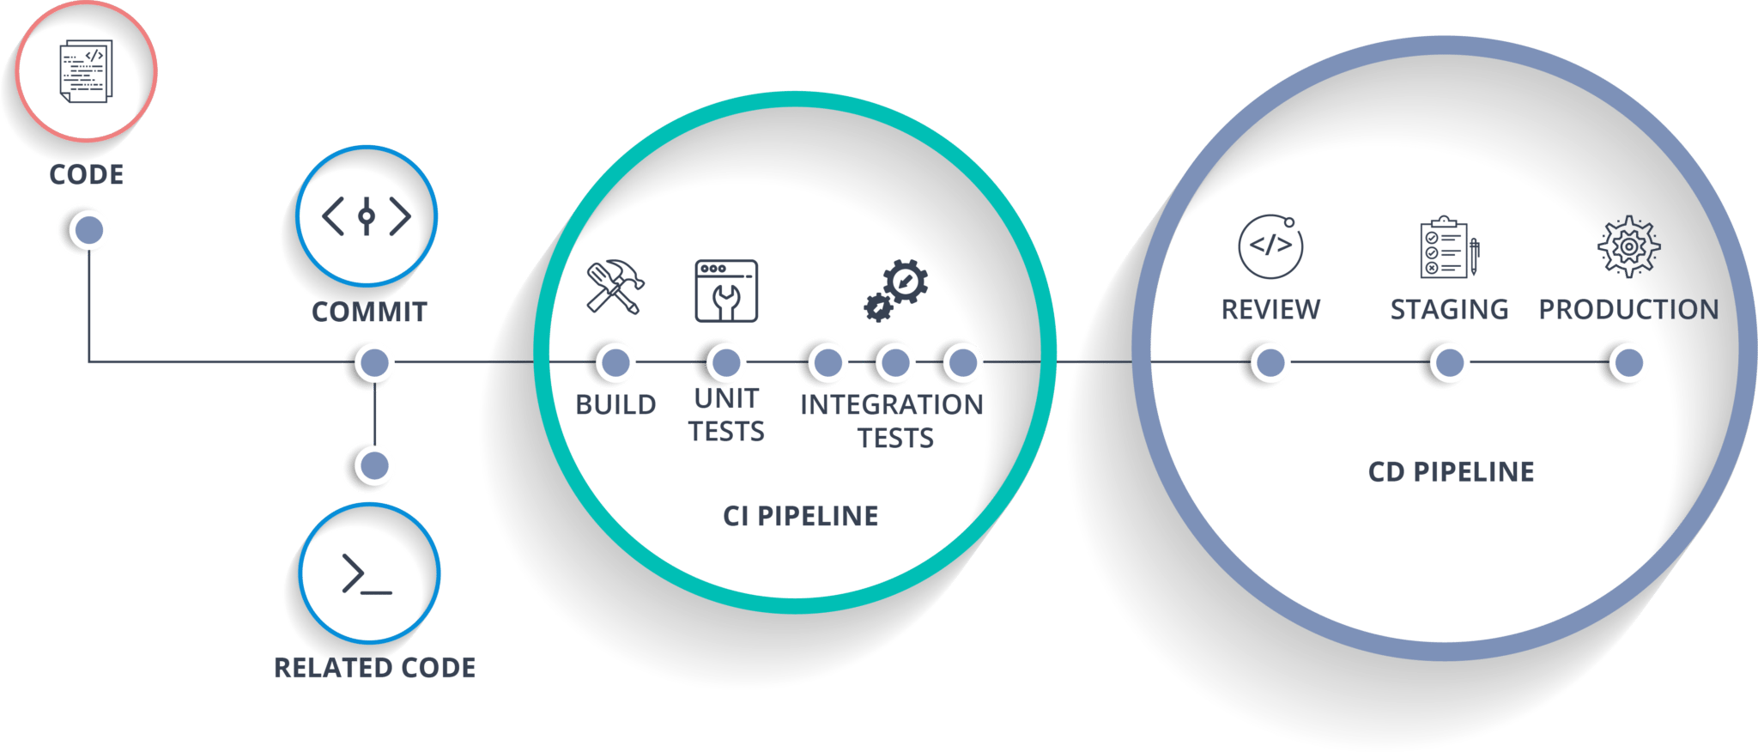
Continuous integration and continuous delivery
Refers to the process of developing and delivering software in short cycles of build-configure-deploy-test-release underpinned by automation.

Slide 15

Containerize
Software containers are a form of OS virtualization where the running container includes just the minimum operating system resources, memory and services required to run an application or service.
Benefits:
Instant startup of operating system resources.
Container Environments can be replicated, to enable high availability.
Disposables.
Two of the most popular containerization software are:
Docker
Kubernetes ( google )
Applications nowadays
Notes:
In other words multiple containers can be use for multiple purposes either to just have your whole hosted or just a service. When trying to deploy a container app, you need a definition for the application, that definition is going to provide all the configuration required in order to deploy the app.
- There should be no emotional attachment to a container as per they should be recyclables.

Slide 16
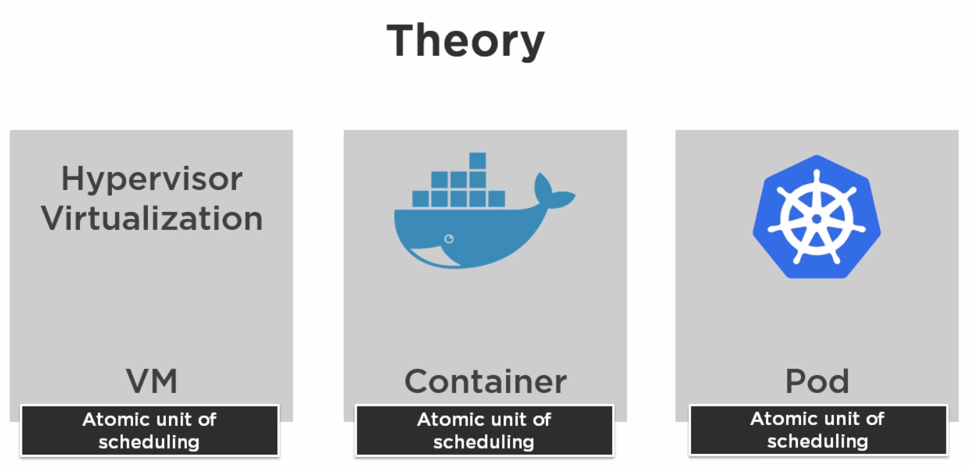
Kubernetes ( K8’s )
Is an orchestrator which allows containers to speak to each other and enables high availability on containers. It works with the pods technology which allows grouping containers in a single host.
What is a pod ?
All pods get it's own IP's and uses that the Ip's to communicate. ( inter-pod )
When a pod has multiple containers uses ports to communicate between them. (intra-pod)
Notes:
K8s is an abbreviation derived by replacing the 8 letters “ubernete” with “8
Pod: Atomic unit of scheduling.
Contain one or more containers. Using a manifest file.
All pods get it's own IP's and uses that the Ip's to communicate. ( inter-pod )
When a pod has multiple containers uses ports to communicate between them. (intra-pod)

Slide 17
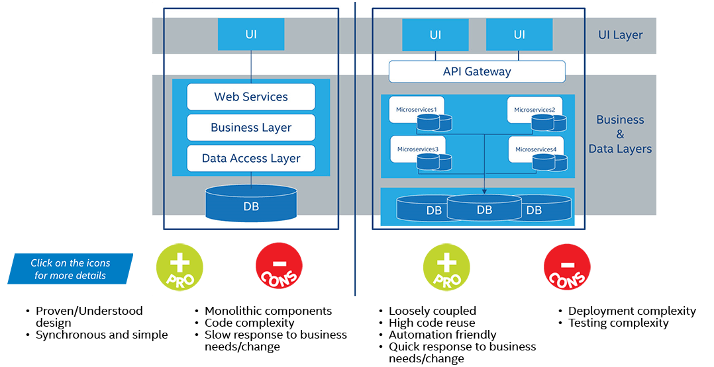
Current proposal model for applications ( cloud model )

Slide 18
Bibliography
Information:
https://hackernoon.com/6-essential-tips-on-how-to-become-a-full-stack-developer-1d10965aaead
https://skillcrush.com/2017/02/27/front-end-back-end-full-stack/
Images:
https://medium.com/@mattAtPlacemint/a-recruiters-guide-to-back-end-front-end-development-6ccba26062aa
https://www.google.com/search?q=API%27s&rlz=1C1GCEA_enUS780US780&tbm=isch&source=iu&ictx=1&fir=9VrRf4LwP6qYfM%253A%252CKMWvmnOdiH99vM%252C%252Fm%252F0z5n&vet=1&usg=AI4_-kRf9AeBKDWVdhDpYEcZsMmf00nsKg&sa=X&ved=2ahUKEwiijffxnqHkAhX1OX0KHdxqDMUQ_B0wFnoECAoQAw#imgrc=5KWQ6E7icxdIuM:&vet=1
https://www.google.com/search?q=mongodb&rlz=1C1GCEA_enUS780US780&source=lnms&tbm=isch&sa=X&ved=0ahUKEwiSgsn0m6TkAhUHJzQIHeJzBfEQ_AUIEygD&biw=1920&bih=937#imgrc=T769qB-NYieOvM:
https://www.google.com/search?q=devops&rlz=1C1GCEA_enUS780US780&tbm=isch&source=iu&ictx=1&fir=8KeXkHBMev1shM%253A%252CRC5ousdMrP1GJM%252C%252Fm%252F0c3tq11&vet=1&usg=AI4_-kTdrSHQ59EwxPNBNFpDE07D-EHkqQ&sa=X&ved=2ahUKEwjZyY_FnaTkAhUCOn0KHXmgB-UQ_B0wHnoECAoQAw&cshid=1566949465402468#imgrc=8KeXkHBMev1shM:&vet=1
https://www.google.com/search?q=ci+cd&rlz=1C1GCEA_enUS780US780&source=lnms&tbm=isch&sa=X&ved=0ahUKEwiG7ML2oKTkAhXRCTQIHc7iD8QQ_AUIEigC&biw=1920&bih=937#imgrc=9zo8pk7vuqU-1M:
https://www.atlassian.com › devops

